Slide 1
Lesson 7
Electrical Power Subsystem

Slide 2
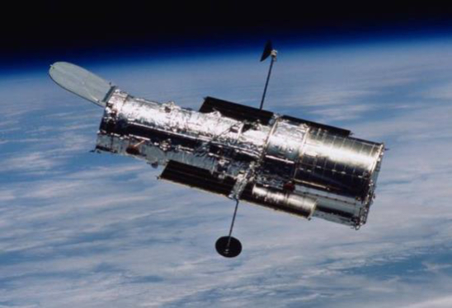
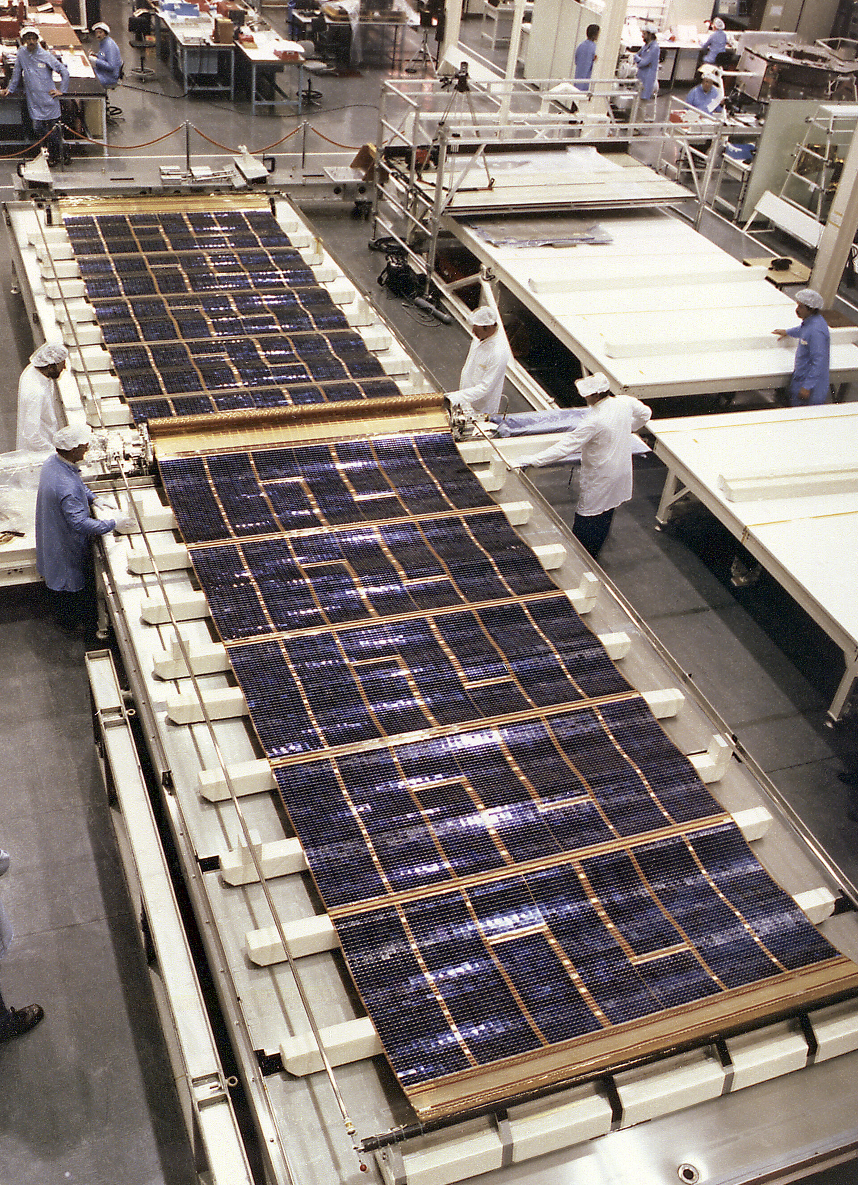
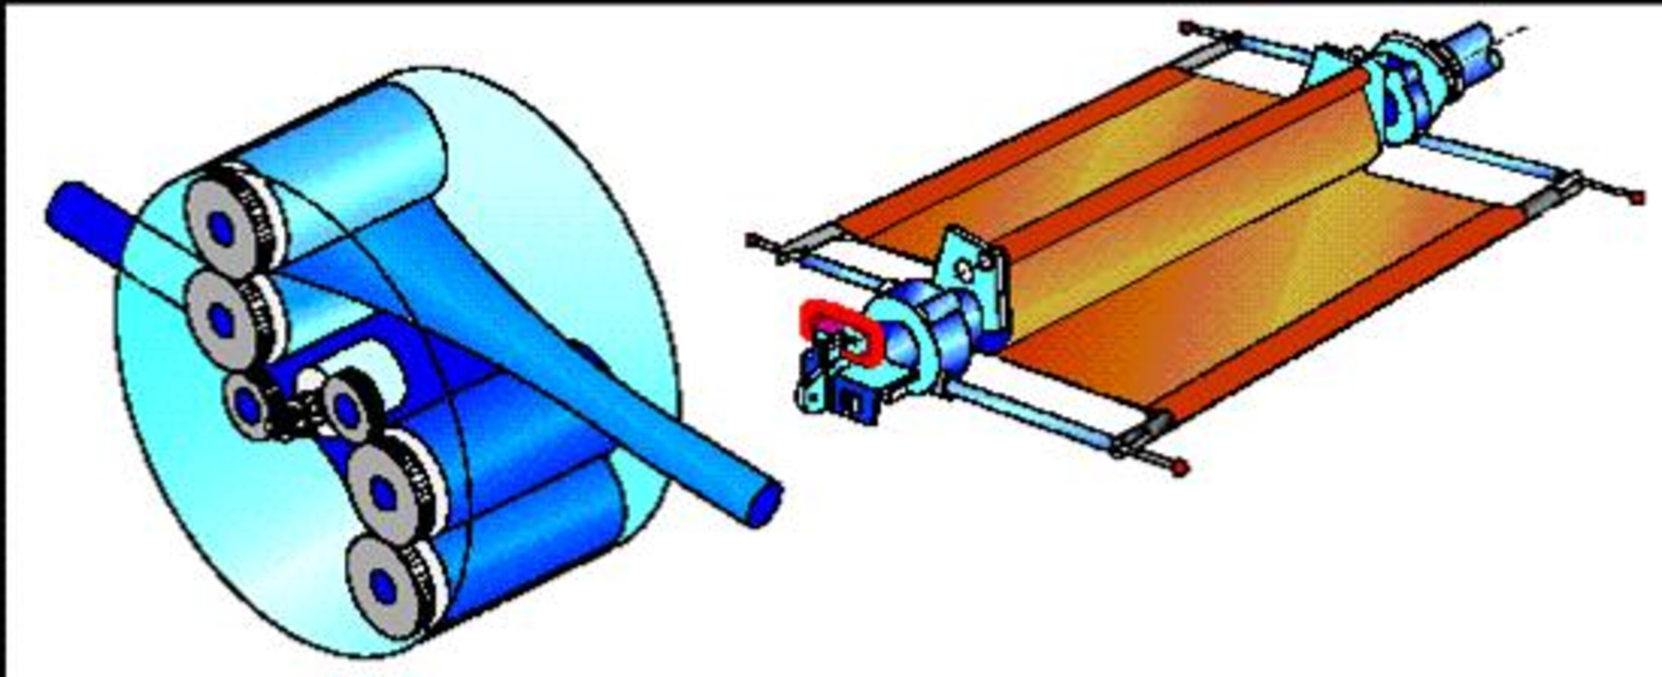
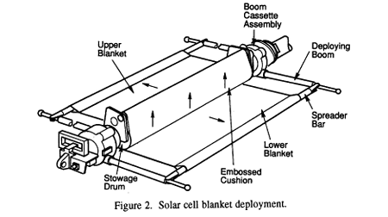
Thermal Jitter
Solar array-induced disturbance of the Hubble Space Telescope's pointing system
Notes:
The Hubble Space Telescope – EPS Challenges
When the Hubble Space Telescope (HST) launched in 1990, its Electrical Power Subsystem was designed around silicon solar arrays and nickel-hydrogen (NiH₂) batteries.
Initial Problems
The original solar arrays were designed in Europe by ESA.
Once in orbit, they experienced “jitter” problems: as Hubble passed in and out of sunlight during each orbit, the solar arrays flexed and vibrated due to thermal changes.
This vibration transferred into the spacecraft, disturbing pointing stability and affecting the fine guidance system.
Upgrades Over Time
During Servicing Mission 2 (1997), astronauts replaced the original solar arrays with newer, smaller, more efficient ones that reduced vibration and generated more power.
Later servicing missions swapped in even more advanced triple-junction gallium arsenide arrays, which doubled Hubble’s power output while being smaller in size.
Batteries were also upgraded from NiH₂ to NiMH and later Li-ion chemistries, improving storage efficiency and extending mission lifetime.
Why It Matters
Without these EPS upgrades, Hubble could not have supported the new, more power-hungry scientific instruments installed during later servicing missions.
Power margin directly determined science capability and mission longevity.
This shows how EPS isn’t just “support hardware”—it enables the science.
Lessons
The Hubble story highlights three key EPS lessons for spacecraft engineers:
Environmental effects matter (thermal cycling caused unexpected vibration).
EPS margin enables growth (more power → more instruments, more science).
Technology advances keep spacecraft alive (modern solar arrays and batteries extended Hubble’s mission decades beyond its original design life).
----------------------------------------
The most significant Hubble solar power problem was
a "jitter" caused by the spacecraft's flexible solar panels experiencing rapid thermal expansion and contraction during orbital day-night cycles. This vibration interfered with the telescope's ability to maintain precise pointing for its scientific observations.
This initial problem was corrected by replacing the original panels, and the subsequent replacements have focused on improving efficiency and stability.
The original solar panel jitter
The initial problem: When Hubble was launched in 1990, its flexible, roll-out solar panels were sensitive to the extreme temperature fluctuations of its low-Earth orbit. Every 97-minute orbit, Hubble transitions between the cold of Earth's shadow (-85∘Cnegative 85 space raised to the composed with power C
−85∘C
) and the heat of full sunlight (+60∘Cpositive 60 space raised to the composed with power C
+60∘C
).
The cause: This dramatic temperature shift caused the panel's supporting booms to bend and expand rapidly, creating a vibration or "jitter" that lasted for several minutes after each sunrise.
The effect: For a telescope that requires extreme stability for high-resolution imaging, this vibration was a major issue. It interfered with Hubble's sensitive pointing controls and reduced its observation time.
The temporary solution: Ground controllers created special software to compensate for the jitter, but this took up computer memory and was not a perfect fix.
The permanent solution: During the first servicing mission in 1993, astronauts replaced the original panels with a redesigned pair. The new arrays were built to be more resistant to thermal changes, eliminating the jitter problem.
Subsequent solar panel replacements
Over its lifetime, Hubble's solar arrays have been replaced twice during Space Shuttle servicing missions to improve power output and increase stability.
First replacement (1993): Astronauts on Servicing Mission 1 (STS-61) replaced the original vibrating panels with a new, flexible set that addressed the thermal-expansion problem.
Second replacement (2002): During Servicing Mission 3B (STS-109), the second set of arrays was replaced with a new, third-generation pair.
The new arrays were derived from the rigid design of Iridium communications satellites.
Although 45% smaller than the previous versions, their increased efficiency produced 25% more power.
Their rigid structure also allowed for more stable observations by minimizing vibrations.
Degradation: The older solar panels, which were returned to Earth for inspection, provided a unique opportunity to study the effects of the space environment. Examination revealed impacts from micrometeoroids and corrosion caused by atomic oxygen.

Slide 3
Quiz
Given:
FalconEye-1 is in a circular orbit with a radius of 8000 km and period of 1.978 hrs.
The bus requires 535 W of power to operate and is always on.
The payload requires 165 W of power to operate and is always on.
Find:
Calculate the power the solar panels must produce to power FalconEye-1 in both the Sun and Eclipse.
Notes:
Preq = 991W

Slide 4
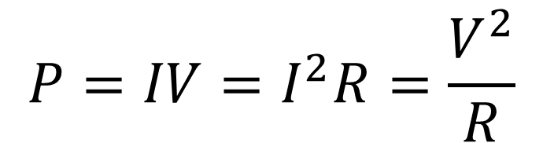
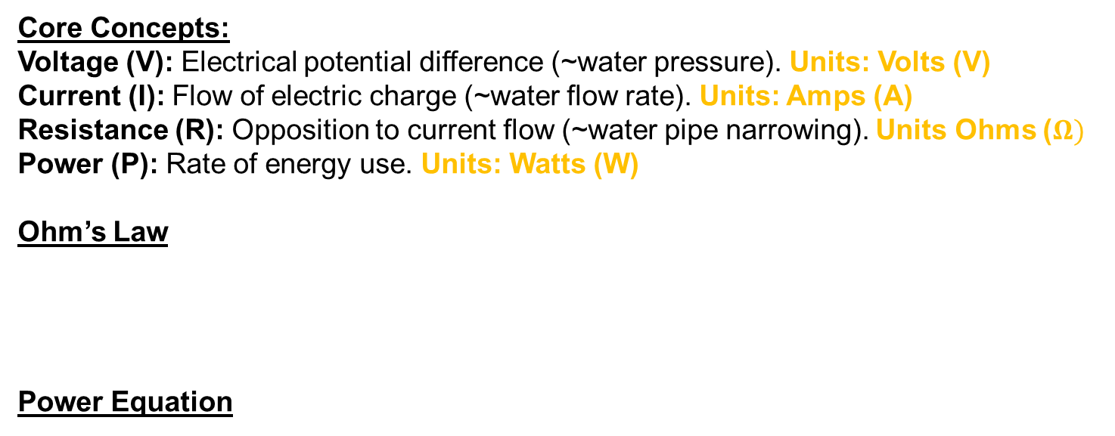

Electricity Fundamentals Review
Core Concepts:
Voltage (V): Electrical potential difference (~water pressure). Units: Volts (V)
Current (I): Flow of electric charge (~water flow rate). Units: Amps (A)
Resistance (R): Opposition to current flow (~water pipe narrowing). Units Ohms ($Ω)$
Power (P): Rate of energy use. Units: Watts (W)
Ohm’s Law
Power Equation
$$V=IR$$
$$P=IV=I^{2}R=\frac{V^{2}}{R}$$
Types of Current:
DC (Direct Current): Constant voltage/polarity — common in spacecraft buses.
AC (Alternating Current): Oscillating — mainly ground test equipment, power conditioning, some motors.

Slide 5
EPS Functions
Energy Source
Provides electrical power (e.g. solar cells or battery)
Energy Conditioning
Provides electrical noise filtering/removes power spikes
Converts to required voltages (a 28-volt bus is common)
Convert from DC to AC
Energy Storage
Stores power for eclipses and peak loads
Energy Distribution
Transfer power to the subsystems that need it

Slide 6
EPS Budget & Requirements
(Simplified) Example Power Budget
Subsystem | Voltage (V) | Max Current (A) | Max Power (W)
CDHS | 28 | 2.9 | 80
Propulsion | 56 | 0.9 | 50
TCS | 12 | 0.8 | 10
ADCS | 28 | 1.4 | 40
Payload | 28 | 7.1 | 200
Total | N/A | 13.1 | 380
EPS Requirements:
Peak power draw
Average power draw
Subsystem voltage (usually a small range)
Subsystem current (often given as typical & max current)
→ Energy Storage (derived requirement)
EPS Considerations (~constraints)
Solar Availability – how often/long are eclipses, how much power from sun (interplanetary)
Degradation – how much will solar panels degrade over the course of the mission

Slide 7
Power Sources
Solar (photovoltaic)
Batteries
Primary
Secondary
Radioisotope Thermoelectric Generator (RTG)
Fuel Cells
Nuclear
Other (see slide)

Slide 8
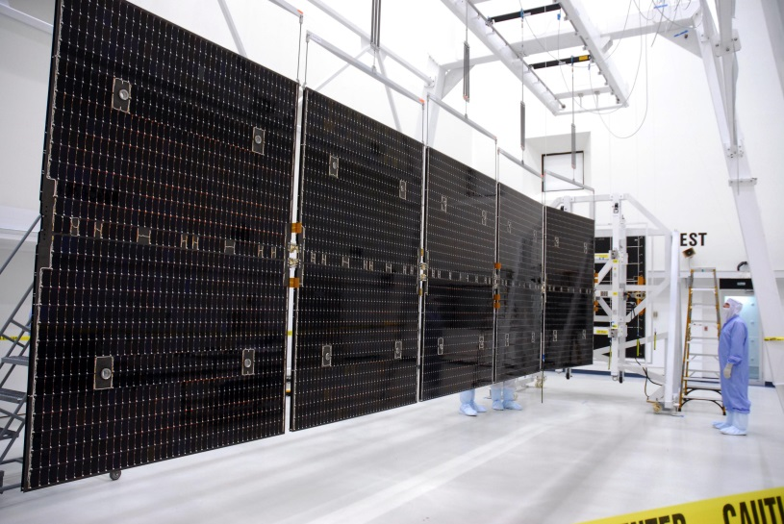
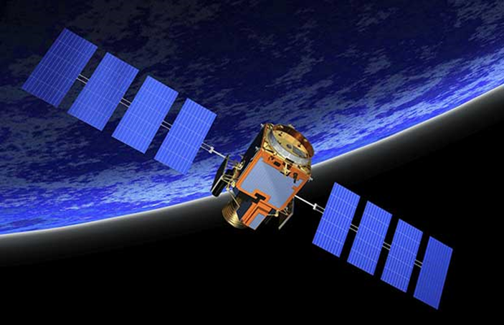
Solar Power (Photovoltaic Cells)
Primary energy source for Earth-orbiting satellites
Common types:
Silicone (Si)
Gallium Arsenide (GaAs)
Multi-junction
Technology | Efficiency | Radiation Tolerance | Mass Efficiency
Silicon | Low | Poor | Low
GaAs | Medium | Good | Medium
Multi-Junction | Very High | Excellent | Very High
Thin-Film | Low–Medium | Variable | Excellent
Notes:
1. Silicon (Si) Solar Cells
Overview
First widely used space solar cell technology.
Typically monocrystalline silicon.
Key Characteristics
Efficiency: ~12–15% (space-qualified)
Radiation tolerance: Poor by modern standards
Temperature performance: Moderate degradation at high temperatures
Mass efficiency: Low (heavy for the power produced)
Typical Use
Early satellites
Educational missions
Very low-cost or heritage-constrained spacecraft
Status
Largely obsolete for modern operational missions.
2. Gallium Arsenide (GaAs) Solar Cells
Overview
Supplanted silicon as the baseline space solar cell in the 1990s.
Key Characteristics
Efficiency: ~18–22%
Radiation tolerance: Significantly better than silicon
Temperature performance: Better high-temperature behavior
Mass efficiency: Moderate
Typical Use
Legacy GEO satellites
Early LEO/MEO spacecraft
Status
Still flown, but increasingly replaced by multi-junction designs.
3. Multi-Junction III–V Solar Cells
Overview
Current state of the art for most operational spacecraft.
Commonly triple-junction (InGaP/GaAs/Ge), with quad-junction variants emerging.
Key Characteristics
Efficiency:
Triple-junction: ~28–32%
Advanced multi-junction: 33–36%+
Radiation tolerance: Excellent
Temperature performance: Strong
Mass efficiency: High (best W/kg)
Typical Use
Modern LEO, MEO, GEO satellites
Deep-space missions
High-power spacecraft (communications, ISR)
Status
Industry standard for performance-driven missions.
4. Thin-Film Solar Cells
Includes:
Amorphous silicon (a-Si)
Copper indium gallium selenide (CIGS)
Cadmium telluride (CdTe)
Key Characteristics
Efficiency: ~8–18% (technology dependent)
Radiation tolerance: Variable
Mass efficiency: Very high (ultra-lightweight, flexible)
Mechanical flexibility: Excellent
Typical Use
Small satellites (CubeSats)
Deployable or conformal arrays
Demonstration missions
Status
Increasing adoption where mass, stowage volume, or deployability dominate over efficiency.

Slide 9
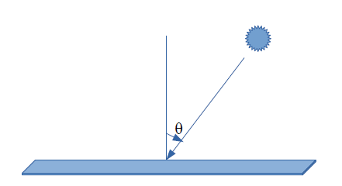
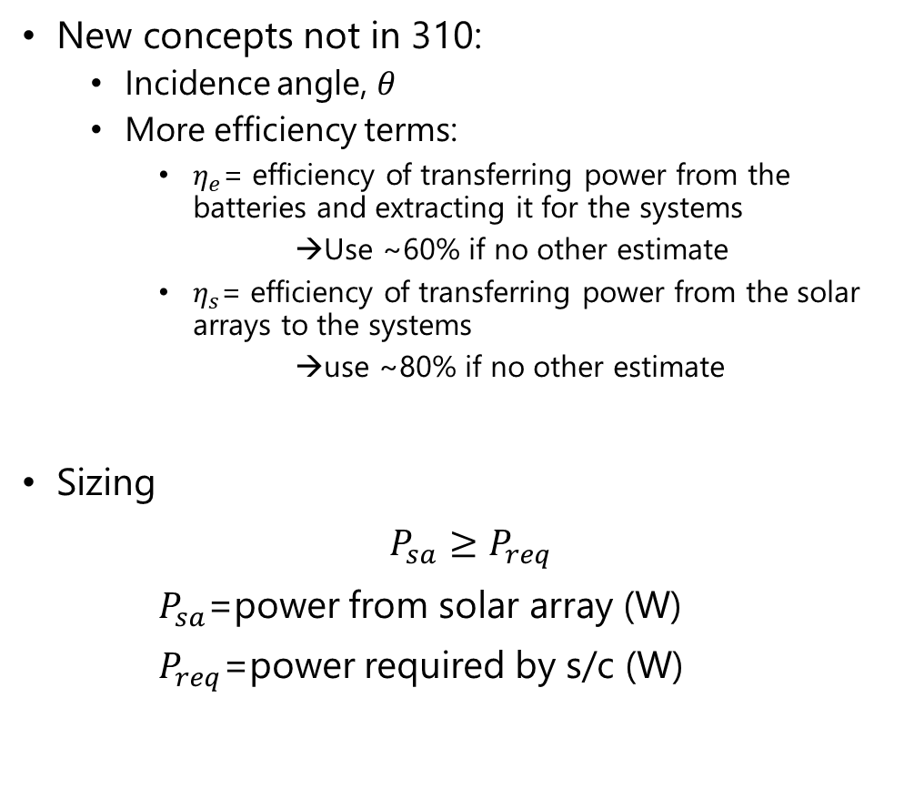
Solar Power Sizing
New concepts not in 310:
Incidence angle, $θ$
More efficiency terms:
$η_{e}$= efficiency of transferring power from the batteries and extracting it for the systems
→Use ~60% if no other estimate
$η_{s}$= efficiency of transferring power from the solar arrays to the systems
→use ~80% if no other estimate
Sizing
$P_{sa}≥P_{req}$
$P_{sa}$=power from solar array (W)
$P_{req}$=power required by s/c (W)
Incidence Angle
Notes:
Hubble solar panels 9 years after install (2002)

Slide 10
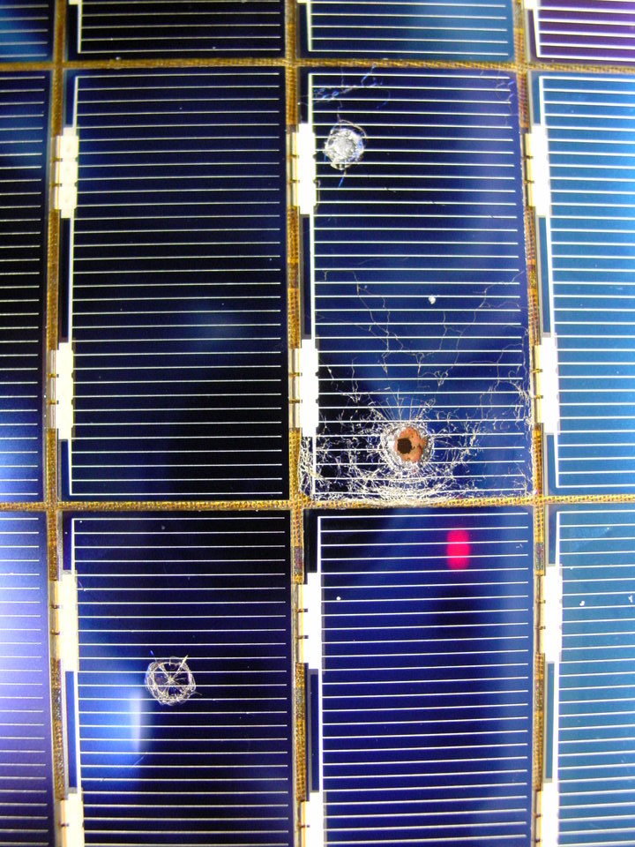
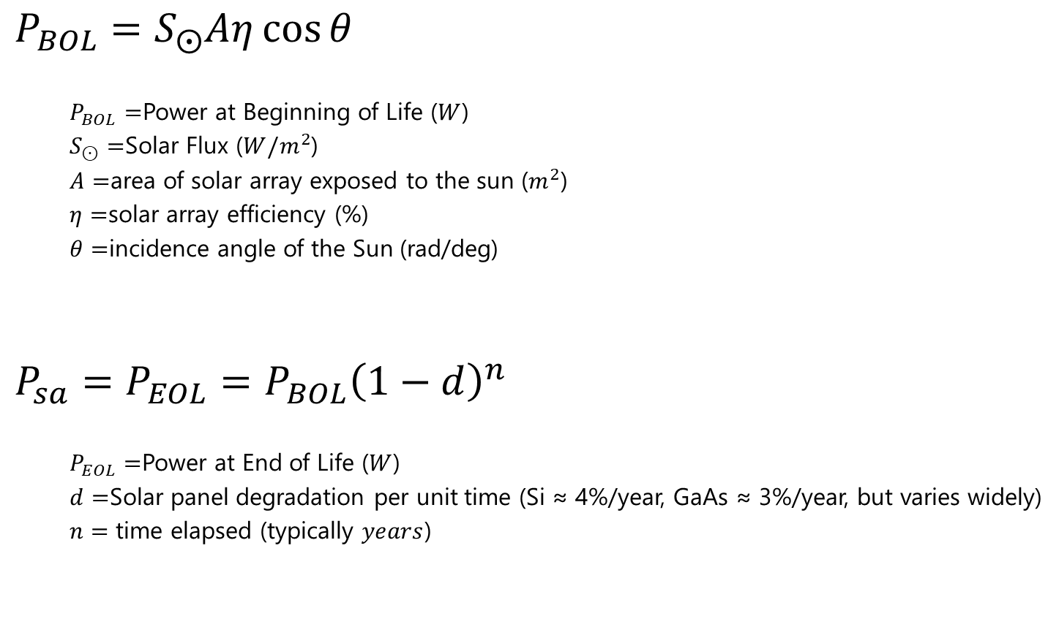
Power from Solar Array ($P_{SA}$ )
$$P_{BOL}=S_{⨀}Aη\cos{θ}$$
$P_{BOL}=$Power at Beginning of Life ($W$)
$S_{⊙}=$Solar Flux ($W/m^{2}$)
$A=$area of solar array exposed to the sun ($m^{2}$)
$η=$solar array efficiency (%)
$θ=$incidence angle of the Sun (rad/deg)
$$P_{sa}=P_{EOL}={P_{BOL}\left(1−d\right)}^{n}$$
$P_{EOL}=$Power at End of Life ($W$)
$d=$Solar panel degradation per unit time (Si ≈ 4%/year, GaAs ≈ 3%/year, but varies widely)
$n=$ time elapsed (typically $years$)
Hubble Solar Cells after ~9 years

Slide 11

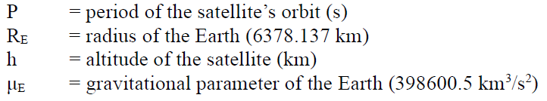

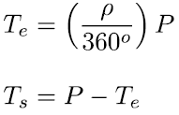

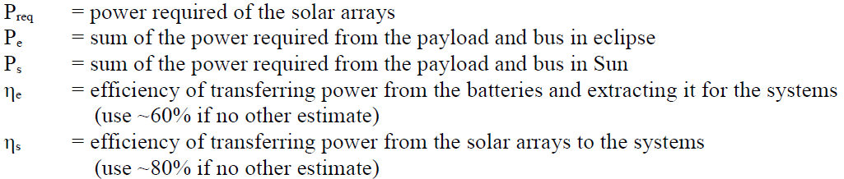
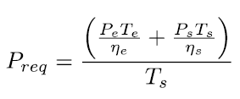

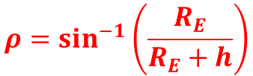
Solar Power Required ($P_{req}$ )
From Dahlke textbook:
Equation sheet defines $ρ$ as radius (half angle!)
$$ρ=\sin^{−1}\left(\frac{R_{E}}{R_{E}+h}\right)$$
$$T_{e}=P\left(\frac{2ρ}{360°}\right)$$
Notes:
Units on rho → deg, to use with T_e equation

Slide 12
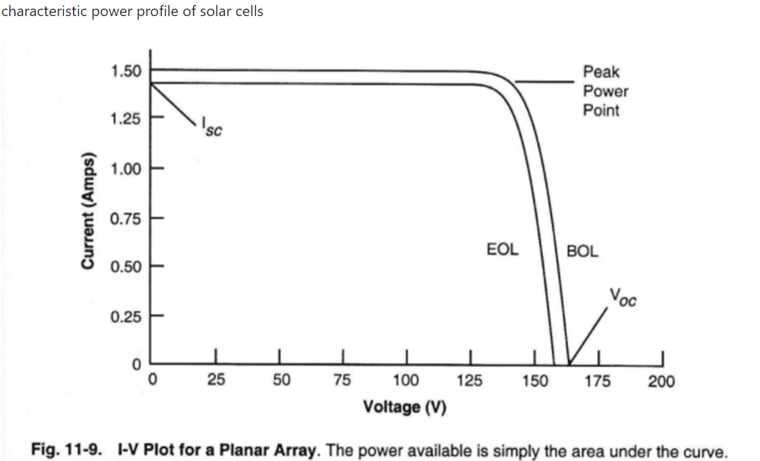
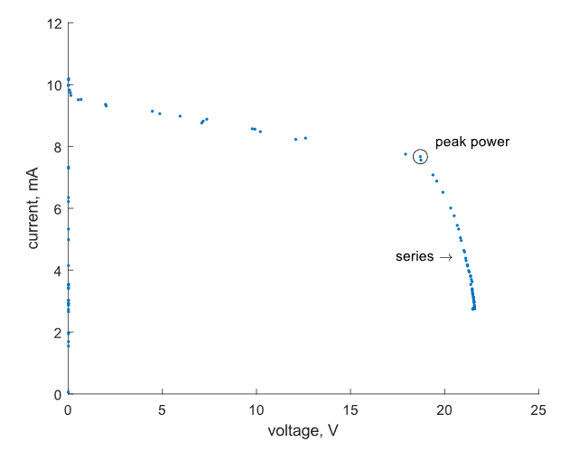

Solar Power Profile (I-V Curve)
Solar panel I–V curve: describes how much current and voltage a solar cell (or array) can produce under a given illumination.
Short-Circuit Current ($I_{sc}$)
Current when the output is shorted (V = 0). Maximum possible current, proportional to illumination level.
Open-Circuit Voltage ($V_{OC}$)
Voltage when no current flows (I = 0). Maximum voltage the cell can produce, depends on material and temperature.
Knee / Maximum Power Point (MPP)
The point on the curve where the product $P=IV$ is maximum. Solar panels and spacecraft EPS are designed to operate near this point using Maximum Power Point Tracking (MPPT).
(MPP)
Ideal
Real data
Notes:
Temperature Effects: High temperatures lower Voc (less available power in hot conditions).
Radiation Damage: Degrades both Isc and Voc over time, reducing total available power.
Eclipse Recovery: After eclipse, panels must quickly re-establish their I–V curve characteristics to recharge batteries.

Slide 13
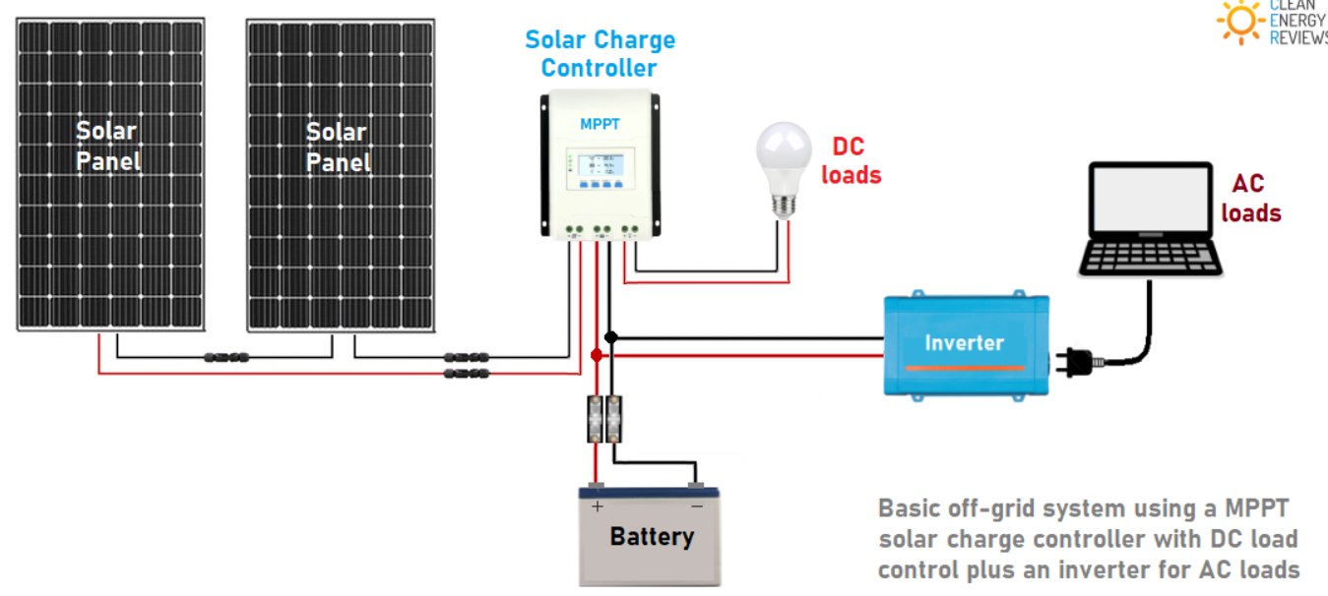

Maximum Power Point Tracking (MPPT)
Method to ensure that solar arrays always operate at their maximum power point (MPP) on the I–V curve.
Continuously adjusts the load seen by the solar array to keep it operating near the knee of the I–V curve.
Maximizes efficiency
$$V=IR$$
Notes:
Control algorithms:
Perturb and Observe (P&O): Slightly vary voltage/current and measure power change.
Incremental Conductance: Compare instantaneous and incremental conductance to find the peak.
Constant Voltage: Keep panel voltage at a fixed fraction of Voc (simpler, less efficient).

Slide 14
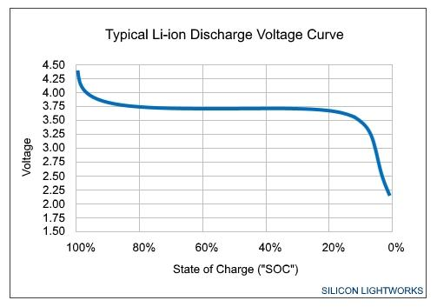
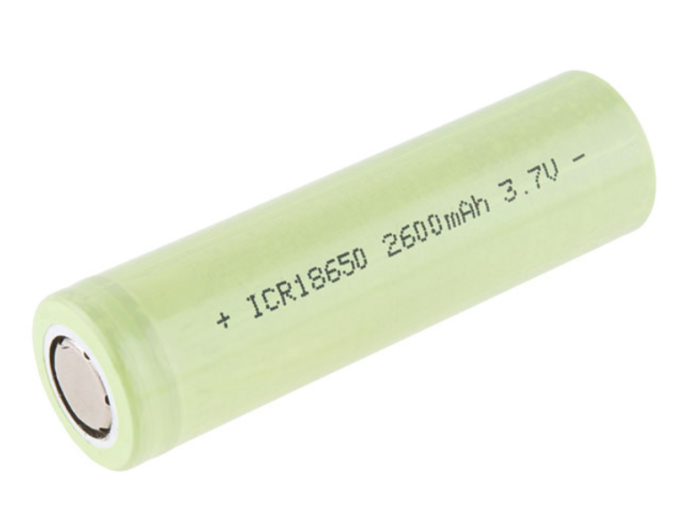
Batteries
Primary - not rechargeable, high energy densities vs. secondary. Types:
Lithium thionyl chloride
Lithium sulfur dioxide
Secondary – rechargeable, used for power during eclipses & peak power load situations. Types:
Nickel-Cadmium (NiCd) – older technology, popular, poor cycle life (few 1000 cycles)
Nickel-hydrogen (NiH₂) – higher energy density and some better cycle life (~40,000 cycles)
Silver-zinc (Ag-Zn) – high energy density, lower cycle life (~100’s cycles)
Lithium Ion (Li-ion) – high energy density, better cycle life (~1000-70000 cycles)
Discharge curve
Li-Ion 18650 Cell
Notes:
Depth of Discharge (DoD): Determines cycle life (shallow discharges = longer life).
Cycle Life: Number of charge/discharge cycles before significant capacity loss.
Temperature Sensitivity: Batteries degrade quickly under thermal stress.
Radiation Effects: Can reduce lifetime, cause internal resistance growth.
Safety: Li-ion requires protection circuits to prevent overcharge/thermal runaway.
Spacecraft Examples
International Space Station (ISS): Started with NiH₂, upgraded to Li-ion batteries during astronaut EVAs.
CubeSats: Typically use COTS Li-ion or Li-poly cells, often in 1S–2S packs.
Mars Rovers (Spirit, Opportunity, Curiosity, Perseverance): Rely on rechargeable Li-ion packs, charged by RTGs or solar arrays.

Slide 15
Battery Comparison
Battery Type | Energy Density | Cycle Life | Pros | Cons | Spacecraft Examples
Nickel-Cadmium (NiCd) | Low (~40–60 Wh/kg) | Moderate (500–1000 cycles) | Simple, robust, tolerant of abuse | Memory effect, heavy, limited lifetime | Early LEO satellites
Nickel-Hydrogen (NiH₂) | Moderate (~50–75 Wh/kg) | Very high (>20,000 cycles) | Extremely long life, tolerant to radiation | Very bulky, heavy, complex plumbing | Hubble Space Telescope, ISS (original)
Nickel-Metal Hydride (NiMH) | Higher (~60–120 Wh/kg) | Medium (1000–2000 cycles) | Better density than NiCd, less memory effect | Self-discharge, limited flight heritage | Some experimental smallsats
Silver-Zinc (Ag-Zn) | High (~100–150 Wh/kg) | Very short (tens of cycles) | High power output, compact, reliable | Expensive, poor cycle life | Apollo spacecraft, crewed reentry vehicles
Lithium-Ion (Li-ion) | High (~120–200 Wh/kg) | Medium (1000–5000 cycles depending on DoD) | High energy density, lightweight, COTS availability | Sensitive to overcharge/thermal runaway, radiation effects | CubeSats, modern GEO & LEO satellites, ISS upgrades
Lithium-Iron-Phosphate (LiFePO₄) | Moderate (~90–140 Wh/kg) | Long (2000–7000 cycles) | Safer than Li-ion, stable under thermal stress | Slightly lower density than Li-ion, newer in space | Emerging in CubeSats and experimental missions
Primary (Non-Rechargeable) Batteries | High (~200–400 Wh/kg depending on chemistry) | One-time use | Very high energy density, simple | Cannot recharge, limited to short missions | Planetary landers, probes (e.g., Galileo atmospheric probe)

Slide 16
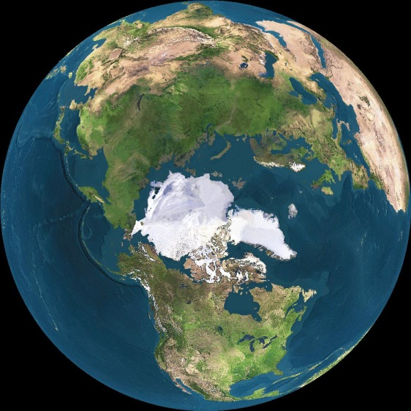
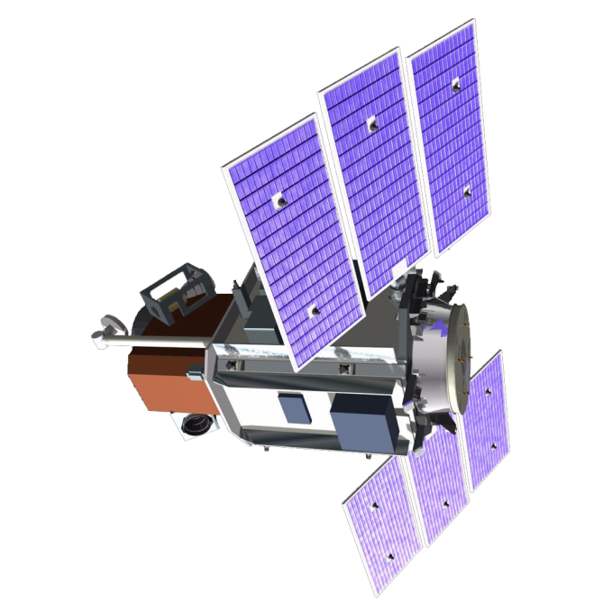
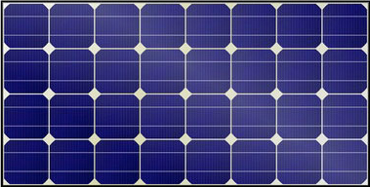
Battery CONOPS
subsystems + payload
battery

Slide 17
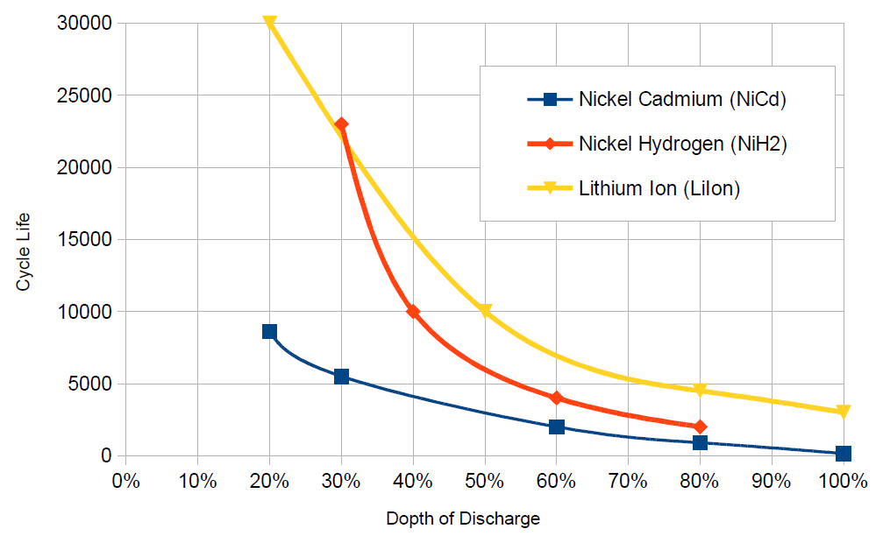
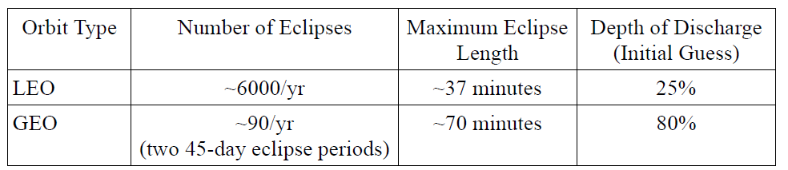
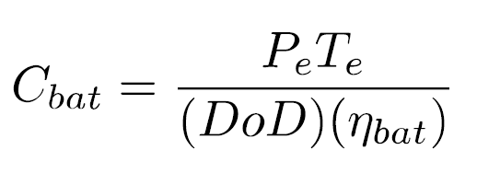
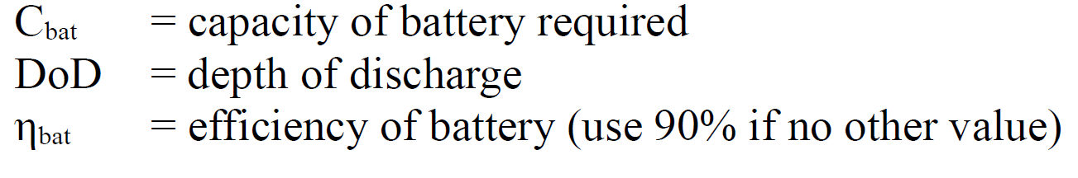

Batteries – Sizing
Depth of Discharge (DoD): % of battery’s total capacity that has been used (discharged) relative to full charge.
State of Charge: SoC=100%−DoD
Required Battery Capacity:
(W-hr)
Example: Given 12V/100A-hr battery, what is battery capacity in W-hr?
$$12∗100=1200 Whrs$$
Notes:
DoD -- Why It Matters
Battery Lifetime:
The deeper the discharge (higher DoD), the fewer charge/discharge cycles the battery can survive.
Shallow cycles (low DoD) → much longer cycle life.
Thermal Effects:
Deep discharges generate more heat and stress internal chemistry.
Mission Design Trade-off:
Spacecraft designers choose a maximum allowable DoD to balance energy needs with battery lifetime.

Slide 18
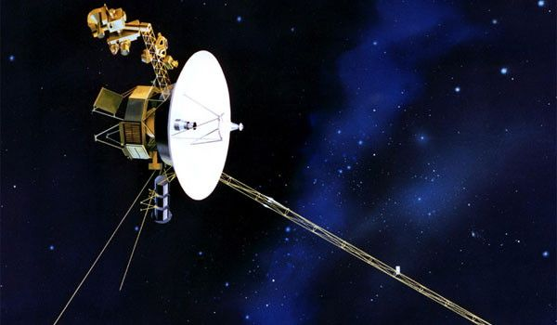
What spacecraft is this?
What is this?
(Why is it here?)
Notes:
Voyager Spacecraft
RTG

Slide 19
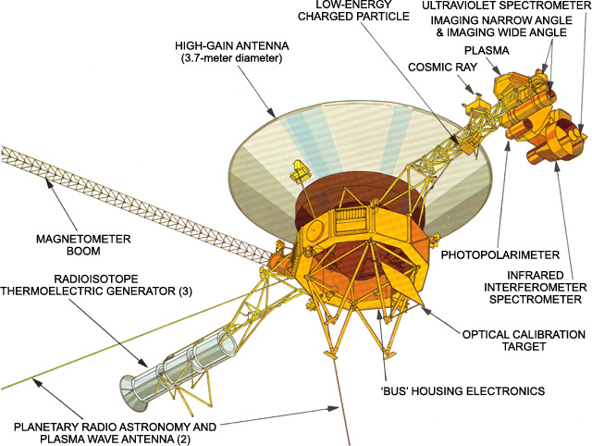
Voyager

Slide 20
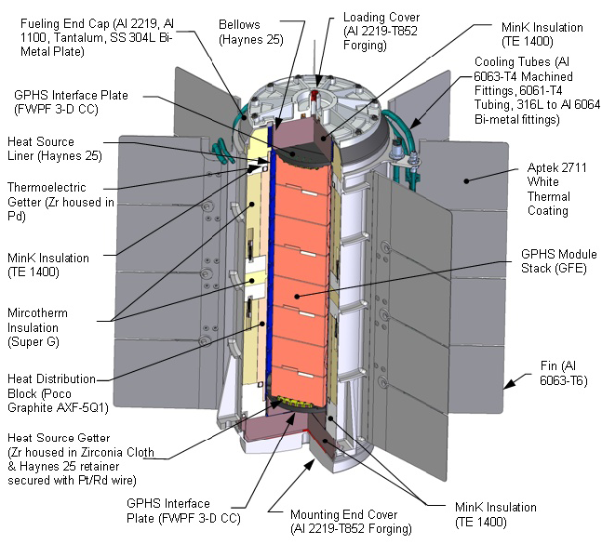
Radioisotope Thermoelectric Generator (RTG)
Converts heat from radioactive decay (plutonium-238) into electricity via thermocouples.
Provides steady, long-duration power where sunlight is weak or unavailable.
Examples: Voyager, Cassini, Curiosity & Perseverance rovers, New Horizons.
Advantages
Long lifespan
Higher energy density relative to solar arrays
Works in solar flux conditions
Compact
Disadvantages
Expensive
Needs Cooling
Needs shielding
Always on
Multi-mission radioisotope thermoelectric generator (MMRTG)
Notes:
RTGs generate power by using thermocouples to generate a voltage. Thermocouples are very reliable and have a very long life. However, there are very inefficient. The efficiencies range from 3-7% (use 5% if no actual value is known.) They produce voltage by connecting two electrical conductors of different material. When one side is heated and the other side is cooled, a voltage potential across the junction is generated. Within the RTG, the decay of radioactive material creates the heat and the coldness of deep space provides the cold.
Plutonium-238 availability is limited, necessitating active production by the US Department of Energy (DOE) to fuel NASA’s deep-space missions. Production restarted in 2015 after a 1988 shutdown, with goals to produce 1.5 kg per year by the mid-2020s. The supply is critical, as it provides heat for Radioisotope Thermoelectric Generators (RTGs) when solar power is not feasible.
Dwindling Reserves: Following the 1988 production stop, the US relied on a shrinking stockpile and Russian imports (which ended in 2010).
Capacity: Prior to the new production, the US stockpile was down to about 77 lbs, with only about half of that deemed usable for missions. (for reference the Curiosity rover used roughly 10 lbs)

Slide 21
Other Power Sources
Fuel Cells
Generate electricity from chemical reactions
e.g., hydrogen + oxygen → water + energy
High energy density, but limited duration (consume reactants).
Examples: Apollo missions, early Space Shuttle flights.
Nuclear
Small fission reactors used on a few missions (Soviet RORSATs, SNAP-10A).
Provide high, continuous power for large spacecraft or electric propulsion.
Being reconsidered for future deep space and lunar missions.
Supercapacitors / Capacitor Banks
Good energy density, fast charging, high self discharge (millions of cycles)
Used as supplemental energy storage for short bursts.
Wireless/Beamed Power
Wireless transmission of energy (microwave/laser) from another spacecraft or surface station (conceptual).

Slide 22
Example
We are planning a 3-year mission for a satellite in a circular 500 km altitude orbit. We will have sun tracking silicon solar panels with 15% efficiency with a 4% annual degradation. The satellite systems will need 500W of continuous power. The efficiency of transferring power directly to the systems is 0.8 and the efficiency if we have to run it through batteries first is 0.6. How big do the solar arrays need to be?
For the satellite in the problem above, estimate the capacity required for the secondary batteries.

Slide 23
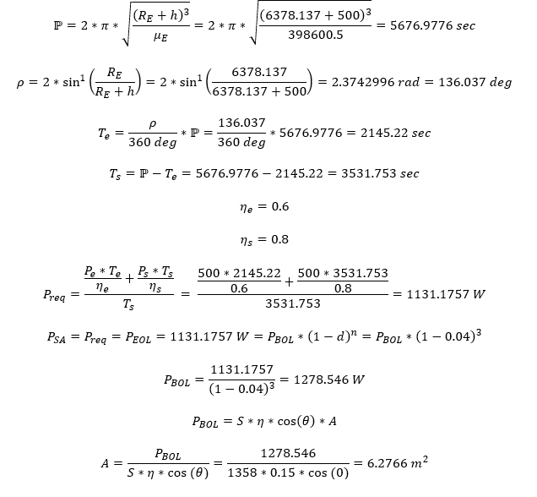
Example - Answer

